Slide 1
Scalability Issues in SDN Control Plane
Internet Architecture

Slide 2
Outline
What is scalability
SDN scalability
Scale controller
Flat structure multiple controllers [ONIX, OSDI’10]
Recursive controller design [Xbar, ONS,13]
Hierarchical controller design [Kandoo, HotSDN’12]
Offload to switch
Offload to switch control plane [Diffane, SIGCOMM’10]
Offload of switch data plane [DevoFlow, SIGCOMM’11]

Slide 3
What is scalability(扩展性 )
Hardware capability of a system to increase performance under an increased load when resources are added
(From Wikipedia Encyclopedia http://en.wikipedia.org/wiki/Scalability)
i.e. ability to add resources to system to support more work
=> Just add machines when need more storage/processing power

Slide 4
分布式系统的可扩展能力
管理Administrative : for an increasing number of organizations or users to share a single distributed system.
功能Functional : to be enhanced by adding new functionality at minimal effort
分布Geographic : to maintain performance, usefulness, or usability regardless of expansion from concentration in a local area to a more distributed geographic pattern
负载Load scalability: to easily expand and contract its resource pool to accommodate heavier or lighter loads
升级Generation scalability: to scale up by using new generations of components.

Slide 5
Scalability approaches
纵向扩展 Scale vertically or scale up : add resource to a single node in a system
Upgrade the installed server processor capacity to a larger one within the same family
横向扩展Scale horizontally or scale out : add nodes to a system
adding more servers in a cluster.

Slide 6

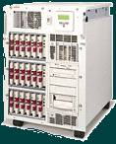


Scale UP
Scale UP: grow by adding components to a single system.
Scale Out: grow by adding more systems.
Scale OUT

Slide 7
What does scalability exepect?
允许使用更多资源avoids inherent design limits on resources
性能随资源增加而增加performance increases with more resouces
开销增加不明显cost increases slowly with more resouces

Slide 8
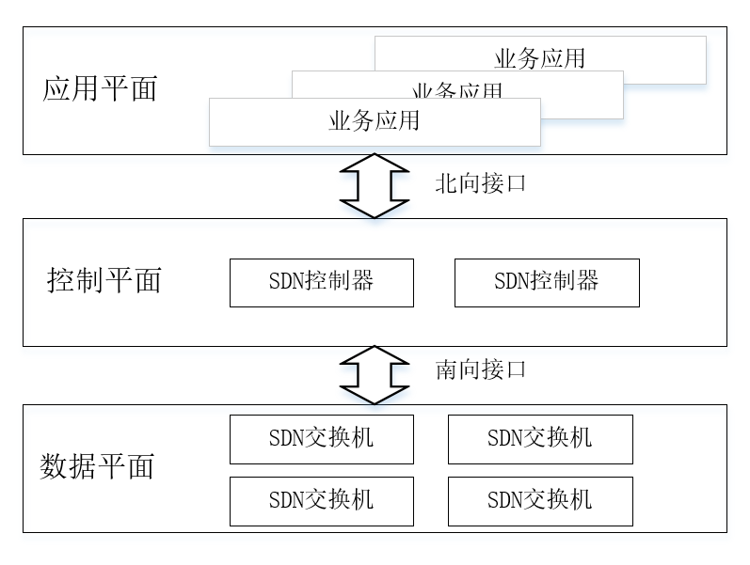
Review
What is the definition of SDN?
The separation of control plane from data plane
data and control plane components can evolve independently, as long as we define a standard application programming interface (API) between the two.
What is the API between control plane and data plane?
OpenFlow protocol

Slide 9
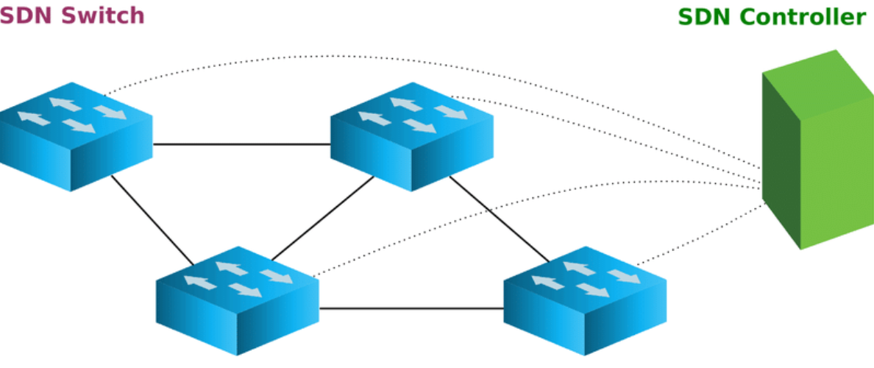
Decoupling
Decoupling data and control planes brings about scalability concerns.
Moving traditionally local control functionalities to a remote controller can potentially result in new bottlenecks
poor scalability
Single Point of Failure
performance bottlenecks, etc

Slide 10
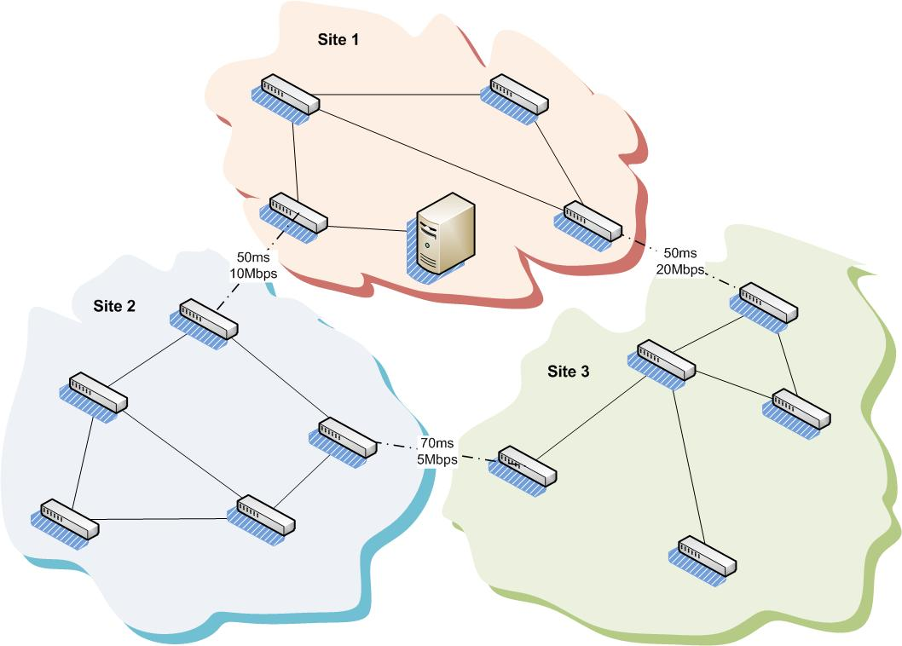
Scalability in Control Plane
SDN design suffered from scalability problems
Network growth（e.g. DCN) →
More traffic; and
Higher CPU load for controller
Geographic distribution (e.g WAN) →
Increased setup latencies

Slide 11
Scalability
Pushing all the control functionality to a centralized controller leads to scalability challenges.
Obviously, a centralized SDN controller does not meet the different requirements of large-scale real-world network deployments.
E.g. large-scale DCN, WAN

Slide 12
Scalability in DCN
E.g. a Data Center Network involves tens of thousands of switching elements.
Such a great number of forwarding elements which can grow at a fast pace is expected to generate a huge number of control events that are enough to overload a single centralized SDN controller.

Slide 13
SDN controller scalability issue
Fundamental issue: the speed gap between data plane and control plane.
SDN controller
Switch OS
Switch OS
Switch OS
Switch HW
Switch HW
Switch HW
10-100 Gbps
10-100 0Mbps
?Mbps

Slide 14


Scalability issues
Frequent events stress the control plane.
Stress controller’s resources.
Control Plane
Data Plane
Stress the control channels.
Data plane can overwhelm control plane by design
Control channel or controller resources
SDN controller has a fundamental scalability issue
Source: Soheil Hassas Yeganeh
Notes:
Highly frequent events consume a lot from the control channel and computing resources.
For example, if we collect network-wide state with high frequency
LOAD ON THE NETWORK

Slide 15
Reliability Issues
For WAN, it typically imposes strict resiliency and latency requirements.
Placing multiple controllers on real WAN topologies can benefit both control plane latency and fault-tolerance

Slide 16
Solution Space for Scalability
Distributed Controllers:
Data Plane Extensions:
Control Plane
Control Plane
Control Plane
Control Plane
Data Plane
Data Plane
Consider this as an intrinsic limitation.
Onix, Devolved Controllers, ...
Delegate more responsibilities to the data plane.
DIFANE, DevoFlow, ...
Source: Soheil Hassas Yeganeh
Notes:
There are two categories of solutions for this problem: 1. ... and 2....

Slide 17
Increase controller capacity - distributed controllers
Flat structure multiple controllers
Structured controller with hierarchy
Control plane
Root Control
Control plane
Control plane
Local Control
Data plane
Data plane

Slide 18
Reduce traffic to controller – offload control to switch
Root Control
Control plane
offload Control
Data plane
Data plane
Offload to switch control plane

Slide 19



Solution Space (Cont’d)
Comes at the cost of visibility.
Still, high control channel consumption.
Control Plane
Control Plane
Control Plane
Control Plane
Data Plane
Data Plane
Need to modify the data plane.
Source: Soheil Hassas Yeganeh
Notes:
The problem with ... is that ...
On the other hand, dataplane extensions result into less visibility
More importantly you need to modify OpenFlow, more optional features, fragmentation, ...

Slide 20
Other Scalability Concerns
Increased load on the controller is only one of the voiced concerns about SDN scalability.
Other concerns
Flow Initiation Overhead
Resiliency to Failures

Slide 21
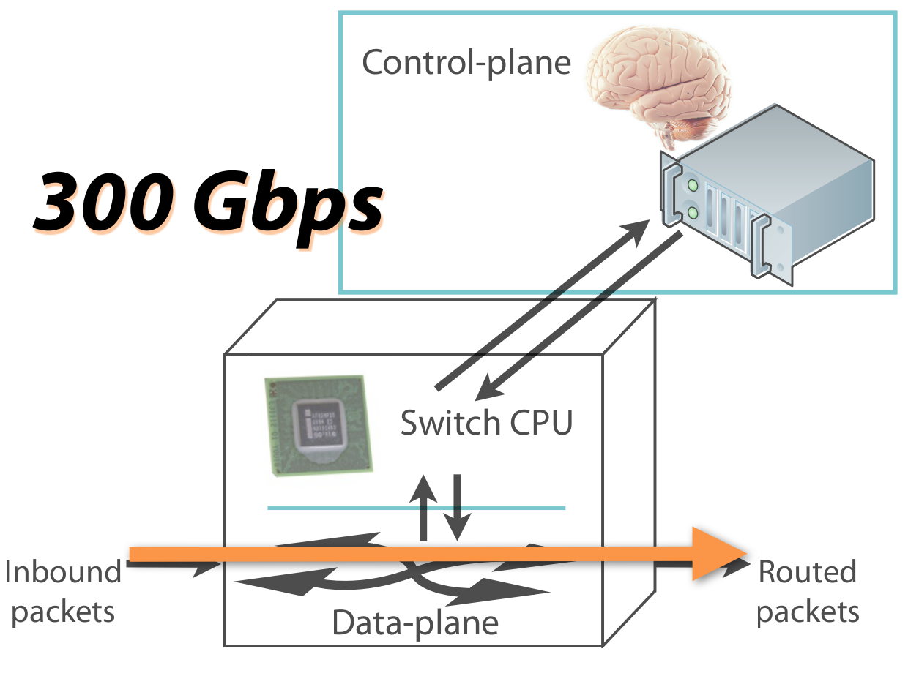
Overheads: Flow Setup
ASIC switching rate
Latency: 5 μs

Slide 22
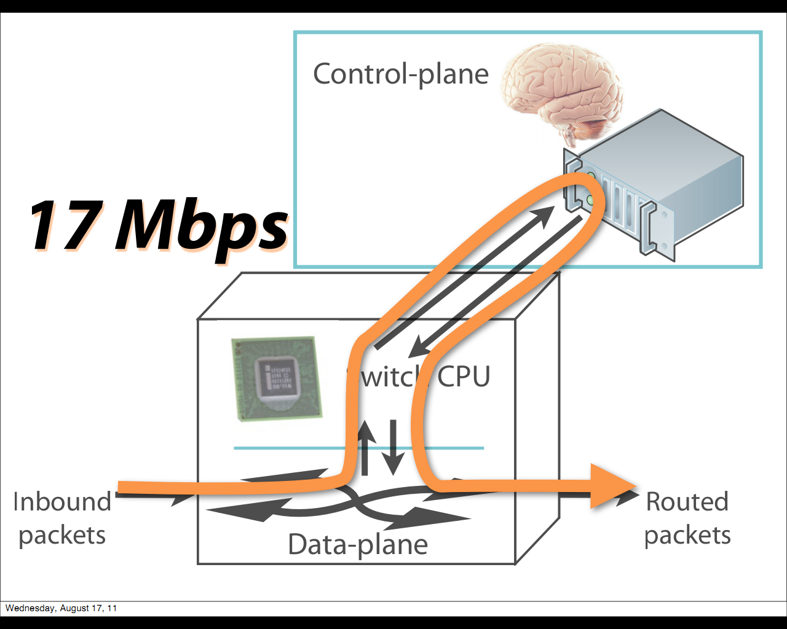
Overheads: Flow Setup
CPU ⇒ Controller
Latency: 2 ms
A huge waste
of resources!

Slide 23
Resiliency to Failures
Resiliency to failures and convergence time after a failure have always been a key concern in network performance.
Controller failure:
A state-synchronized slave controller would be sufficient to recover from controller failures
Link or switch failure
More complex

Slide 24
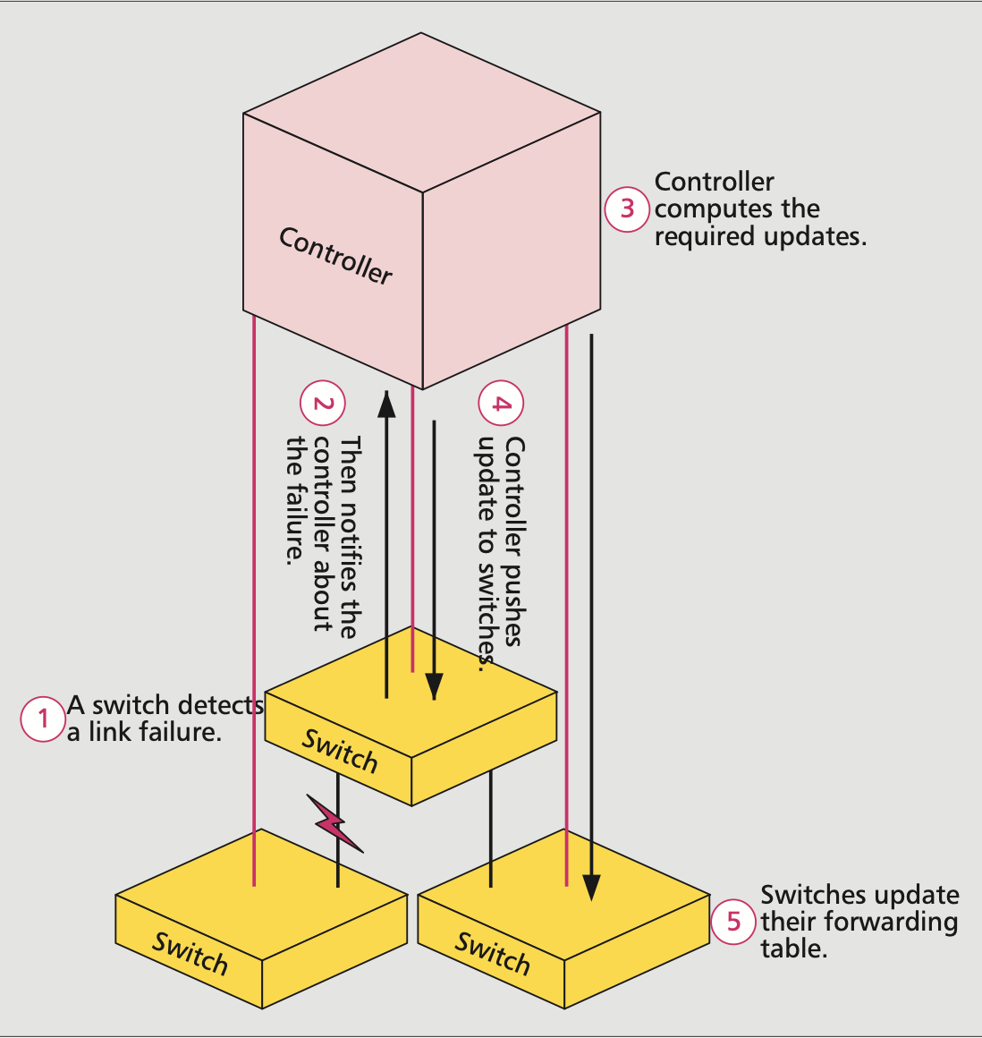
Link or switch failure
Network partition
a network partition would leave half of the network brainless (assume only one controller)
Huge latency in reparing a link
switch detects a change.
the switch notifies the controller
control program computes the repair actions and pushes updates to the affected data path
Switches update their forwarding tables

Slide 25
ONIX: Distributed Controller
Abstractions: It provides general API for management applications.
Basic functionalities:
State distribution primitives between controllers and network elements.
Virtualized network elements

Slide 26
Design Requirements
Generality: Support a wide range of network management applications
Scalability: No inherent limitations due to the platform
Reliability: Graceful failure handling
Simplicity: Network management applications should become simpler
Performance: Sufficient performance

Slide 27
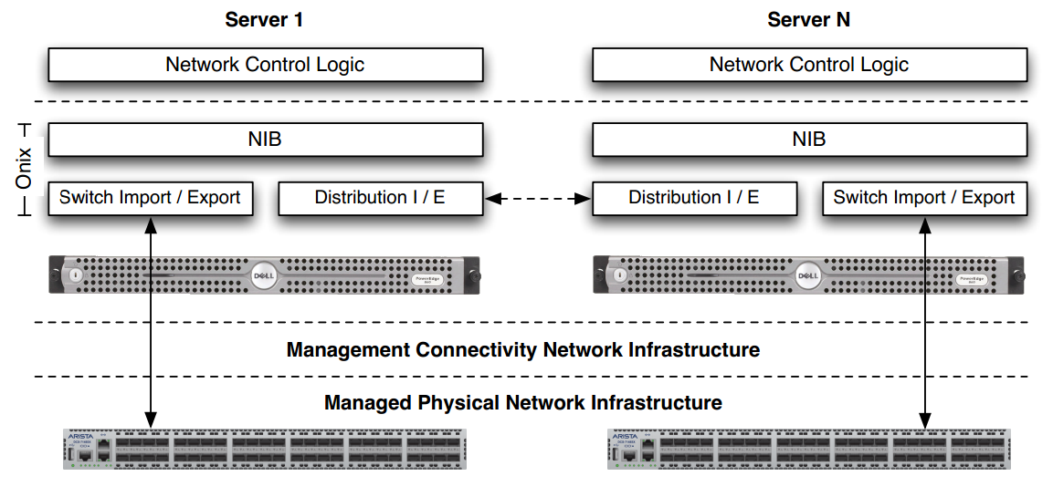
Onix Architecture

Slide 28
Four components of Onix
Physical infrastructure: switches, routers, and other things.
Connectivity infrastructure: Channels for control messages.
Onix: A distributed system running the controller.
Control logic: Network management applications on top of Onix.

Slide 29
Onix Abstractions
Global View: Observe and control a centralized network view which contains all physical network elements.
Flows: The packet and subsequent packets with the same header are treated in the same way.
Switch: <header: counters, actions>
Event-based operation: The controller operations are triggered by routers or applications.
Do you like these abstractions for networking management? Why?

Slide 30
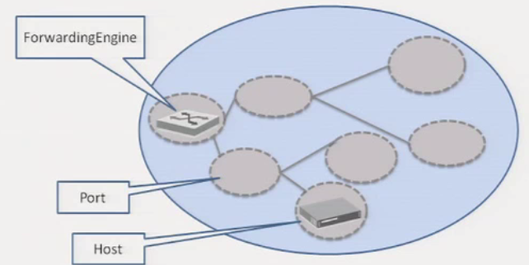
Onix API
Developers program against a network graph
Nodes represent physical network entities
Write flow entry
List ports
Register for updates
……

Slide 31
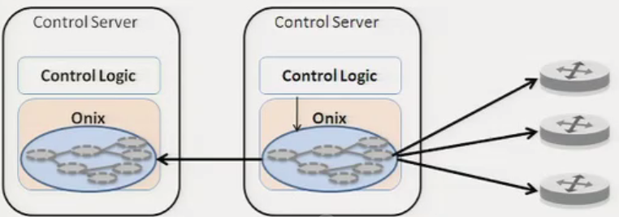
Network Information Base
The NIB is the focal point of the system
State for applications to access
External state changes imported into it
Local state changes exported from it

Slide 32
Scalability and Reliability
A single physical controller will become the bottlenecks:
Memory: to keep NIB
CPU and bandwidth: to process events
Solutions: Partitioning and aggregation
Now, either performance or consistency will suffer.

Slide 33
Scalability/Reliability Requirements
Lets the applications decide the preference for durability and consistency.
Onix provides two built-in storage options
Replicated transactions (SQL) storage
One-hop memory-based DHT
What if there are conflicts? The applications should detect and resolve conflicts.

Slide 34
Discussion: Consistency
Do we need strong consistency for forwarding state between the controller and routers?
Do we need strong consistency for NIB stored in controllers?
Can Onix do better than asking applications for consistency preference and resolving conflicts?

Slide 35
Scaling: Partitioning
Multiple dimensions available to applications:
Onix instances with different computations tasks
Onix instances have only subsets of the NIB
Switches connect to a subset of Onix instances

Slide 36
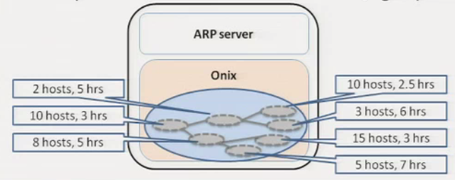
Scaling: aggregation
Reduce fidelity of information before disseminating within the cluster

Slide 37
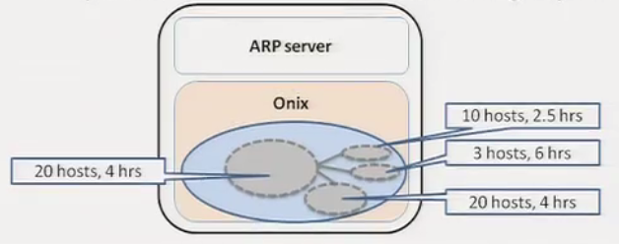
Scaling: aggregation
Reduce fidelity of information before disseminating within the cluster

Slide 38
Reliability
Network Element & Link Failures: Applications' responsibility
Connectivity Infrastructure Failures: Assumed reliable
Onix Failures: Onix provides distributed coordination facilities provided for app failover

Slide 39
Summary
Onix solves state distribution for developers
The designers of management applications still have to understand the scalability implications of their design

Slide 40
Outline
SDN scalability
Scale controller
Flat structure multiple controllers [ONIX, OSDI’10]
Recursive controller design [Xbar, ONS,13]
Hierarchical controller design [Kandoo, HotSDN’12]
Offload to switch
Offload to switch control plane [Diffane, SIGCOMM’10]
Offload of switch data plane [DevoFlow, SIGCOMM’11]

Slide 41
Question
How to design the SDN control plane for a large and globally distributed network?
the key to scaling network systems is aggregating smaller units for forwarding into larger ones.

Slide 42
Vision for such a control plane
A recursive building block — the Logical xBar.
Incorporate hierarchy into SDN

Slide 43
Incorporate Recursion into SDN
Aggregation/hierarchy/recursion are the proven method for scaling networks
Recursive hierarchy is the midway point between centralized and distributed
Looks centralized at any particular level
But introduces points for aggregation, failure domains, etc.
Source: Murphy Mccauley

Slide 44
Implementing RSDN Control Logic
Controller knows its children and its parent
Keeps necessary local state
Logic broken up into:
Aggregation functions – transform info from children to local state
Fan-out functions – transform local state to info for children
Not a strict requirement
Source: Murphy Mccauley

Slide 45
Two building blocks
Logical xBar：
a programmable entity that can switch packets between ports.
a “first order” xBar could merely be an OpenFlow switch.
Logical Server
i.e. the controller: forwarding table management and control plane computations
each logical server computes only the portions of the total network configuration relevant to its direct children,

Slide 46
Example: Logical xBars (LXBs)
Specific RSDN control logic that supports a recursive programmable switch abstraction
Each controller looks like switch to its parent
Transforms table entries from parent to children (more abstract → more specific)
Uses label versioning to support transactional changes at each level
Source: Murphy Mccauley

Slide 47
Hierarchy
Indeed, rather than arbitrary clusterings of switches, we expect the edges of most logical xBars to fall on natural physical or administrative boundaries,
e.g., PoP-based xBars aggregated into regional network xBars aggregated into continental network xBars, or individual LAN xBars aggregated into building xBars aggregated into campus xBars.

Slide 48
LXBs: Handling Failures
Source: Murphy Mccauley

Slide 49
LXBs: Handling Failures
Source: Murphy Mccauley
Notes:
Link handled by…

Slide 50
LXBs: Handling Failures
Source: Murphy Mccauley
Notes:
Link handled by…

Slide 51
LXBs: Handling Failures
Config
State
Source: Murphy Mccauley
Notes:
Link handled by…
State up, config down

Slide 52
LXBs: Some Questions
How good is LXB-based failure localization?
How optimal are LXB-based paths?
How do you optimally divide network into hierarchical subgraphs (e.g., LXBs)?
We don’t!
Not even for evaluation (we use naïve clustering)
Source: Murphy Mccauley
Notes:
Assumption is that in general, clustering is dictated by technology, organization, geography

Slide 53
Summary
Single mechanism for entire control plane:
Hopefully true even across technologies (we have mostly been thinking about copper)
Standard benefits of hierarchy:
Failures localized, churn is contained
Maps to organizational boundaries
Stacks arbitrarily high to meet needs
Source: Murphy Mccauley

Slide 54
Next Steps
Mapping to provider network topologies
Addressing regulatory boundaries
Multitechnology issues (e.g., copper, fiber, wireless)
… ?
Source: Murphy Mccauley

Slide 55
Outline
SDN scalability
Scale controller
Flat structure multiple controllers [ONIX, OSDI’10]
Recursive controller design [Xbar, ONS,13]
Hierarchical controller design [Kandoo, HotSDN’12]
Offload to switch
Offload to switch control plane [Diffane, SIGCOMM’10]
Offload of switch data plane [DevoFlow, SIGCOMM’11]

Slide 56


Kandoo: The IDEA
OFFLOADING
LOCAL CONTROL APPS
TO
LOCAL RESOURCES.
Applications that do not need the network-wide state.
Resources close to switches.
Source: Soheil Hassas Yeganeh
Notes:
Our answer to this question is based on offloading control applications that ... to resources close to switches.
In the next couple of slides I will explain ...

Slide 57



Local Apps
An assumption in distributed controllers:
All control apps require the network-wide state.
But, there are many apps that are local in scope:
Applications that require only local switch state.
App
Controller
App
Controller
Controller
Local App
Local App
App
Switch
Switch
Switch
Switch
Switches
Source: Soheil Hassas Yeganeh

Slide 58

Local apps.
Local applications:
Learning Switch
Local Policy Enforcer
Link Discovery
Local components in control applications:
Elephant Flow Detection in an Elephant Flow Rerouting application.
Local apps have implicit parallelism.
Local App
Local App
Local App
Local App
Switch
Switch
Switch
Switch
Source: Soheil Hassas Yeganeh
Notes:
are either local in nature such as ....
are local components in a larger non-local app! for example

Slide 59



Local Resources
We can offload local apps to computing resources next to switches.
Inside programmable switches.
On the same hosts running software switches.
Hosts close to switches.
End-Host
End-Host
Switch
Local App
Local App
Local App
Soft. Switch
Programmable
Switch
Switch
Source: Soheil Hassas Yeganeh

Slide 60
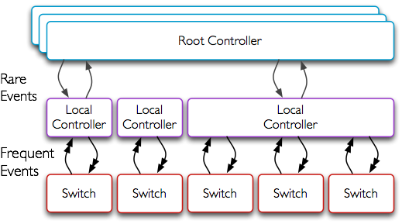




Kandoo
Two layers of controllers:
A logically centralized Root Controller.
Local Controllers.
The root controller runs non-local apps.
Local controllers run local apps.
Lightweight and easy to implement.
Local controllers shield the root controller.
Source: Soheil Hassas Yeganeh

Slide 61
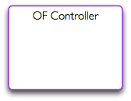
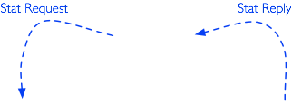




An Example: Elephant flow rerouteing.
Source: Soheil Hassas Yeganeh

Slide 62


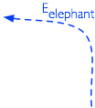

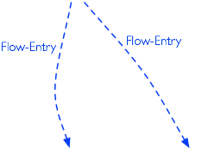



An Example: Elephant flow rerouteing.
Kandoo’s event channels.
Application-specific events.
Scales linearly with the number of switches.
Source: Soheil Hassas Yeganeh

Slide 63
Future directions
A Generalized Hierarchy
Filling the gap between local and non-local apps
Finding the right scope is quite challenging
Finding the right scope is quite challenging
Source: Soheil Hassas Yeganeh

Slide 64
Outline
SDN scalability
Scale controller
Flat structure multiple controllers [ONIX, OSDI’10]
Recursive controller design [Xbar, ONS,13]
Hierarchical controller design [Kandoo, HotSDN’12]
Offload to switch
Offload to switch control plane [Diffane, SIGCOMM’10]
Offload of switch data plane [DevoFlow, SIGCOMM’11]

Slide 65


What’s DIFANE?
Traditional enterprise
Hard to manage
Limited policies
Distributed
Flow-based networking
Easy to manage
Support fine-grained policy
Scalability remains a challenge
DIFANE:
A scalable way to apply fine-grained policies in enterprises
Source: Minlan Yu

Slide 66



Flexible Policies in Enterprises
Access control
Drop packets from
malicious hosts
Customized routing
Direct Skype calls on
a low-latency path
Measurement
Collect detailed HTTP traffic statistics
HTTP
HTTP
Source: Minlan Yu

Slide 67
Flow-based Switches
Install rules in flow-based switches
Store rules in high speed memory (TCAM)
Perform simple actions based on rules
Rules: Match on bits in the packet header
Actions: Drop, forward, count
Flow space
src.
forward via link 1
dst.
drop
Source: Minlan Yu

Slide 68
Challenges of Policy-Based Management
Policy-based network management
Specify high-level policies in a management system
Enforce low-level rules in the switches
Challenges
Large number of hosts, switches and policies
Limited TCAM space in switches
Support host mobility
No hardware changes to commodity switches
Source: Minlan Yu

Slide 69

Pre-install Rules in Switches
Pre-install
rules
Controller
Packets hit
the rules
Forward
Problems:
No host mobility support
Switches do not have enough memory
Source: Minlan Yu

Slide 70
Install Rules on Demand (Ethane, NOX)
Buffer and send
packet header
to the controller
Controller
Install
rules
First packet
misses the rules
Forward
Problems:
Delay of going through the controller
Switch complexity
Misbehaving hosts
Source: Minlan Yu

Slide 71
DIFANE Architecture (two stages)
DIstributed Flow Architecture
for Networked Enterprises

Slide 72
Stage 1
The controller proactively generates the rules and distributes them to authority switches.
Source: Minlan Yu

Slide 73
Partition and Distribute the Flow Rules
Flow space
accept
Controller
Distribute partition information
AuthoritySwitch B
Authority Switch A
Authority Switch C
reject
Authority
Switch B
Egress Switch
Authority
Switch A
Ingress Switch
Authority
Switch C
Source: Minlan Yu

Slide 74
Stage 2
The authority switches keep packets always in the data plane and reactively cache rules.
Source: Minlan Yu

Slide 75
Packet Redirection and Rule Caching
Authority Switch
Feedback:
Cache rules
Ingress Switch
Forward
Egress Switch
Redirect
First packet
Following packets
Hit cached rules and forward
A slightly longer path in the data plane is faster than going through the control plane
Source: Minlan Yu

Slide 76
Locate Authority Switches
Partition information in ingress switches
Using a small set of coarse-grained wildcard rules
… to locate the authority switch for each packet
Distributed directory service but not DHT
Hashing does not work for wildcards
Keys can have wildcards in arbitrary bit positions
AuthoritySwitch B
X:0-1 Y:0-3 ➔ A
X:2-5 Y: 0-1➔B
X:2-5 Y:2-3 ➔ C
Authority Switch A
Authority Switch C
Source: Minlan Yu

Slide 77
Packet Redirection and Rule Caching
Authority Switch
Feedback:
Cache rules
Ingress Switch
Redirect
Auth. Rules
Forward
Egress Switch
First packet
Cache Rules
Partition Rules
Following packets
Hit cached rules and forward
Source: Minlan Yu

Slide 78
Three Sets of Rules in TCAM
Type | Priority | Field 1 | Field 2 | Action | Timeout
Cache Rules | 210 | 00** | 111* | Forward to Switch B | 10 sec
 | 209 | 1110 | 11** | Drop | 10 sec
 | … | … | … | … | …
Authority Rules | 110 | 00** | 001* | Forward Trigger cache manager | Infinity
 | 109 | 0001 | 0*** | Drop, Trigger cache manager
 | … | … | … | … | …
Partition Rules | 15 | 0*** | 000* | Redirect to auth. switch
 | 14 |  |  | …
 | … | … | … | … | …
In ingress switches
reactively installed by authority switches
In authority switches
proactively installed by controller
In every switch
proactively installed by controller
Source: Minlan Yu

Slide 79
DIFANE Switch Prototype _{Built with OpenFlow switch}
Cache rules
Recv Cache
Updates
Send Cache
Updates
Only in Auth. Switches
Control Plane
Cache
Manager
Notification
Just software modification for authority switches
Cache Rules
Data
Plane
Authority Rules
Partition Rules
Source: Minlan Yu

Slide 80
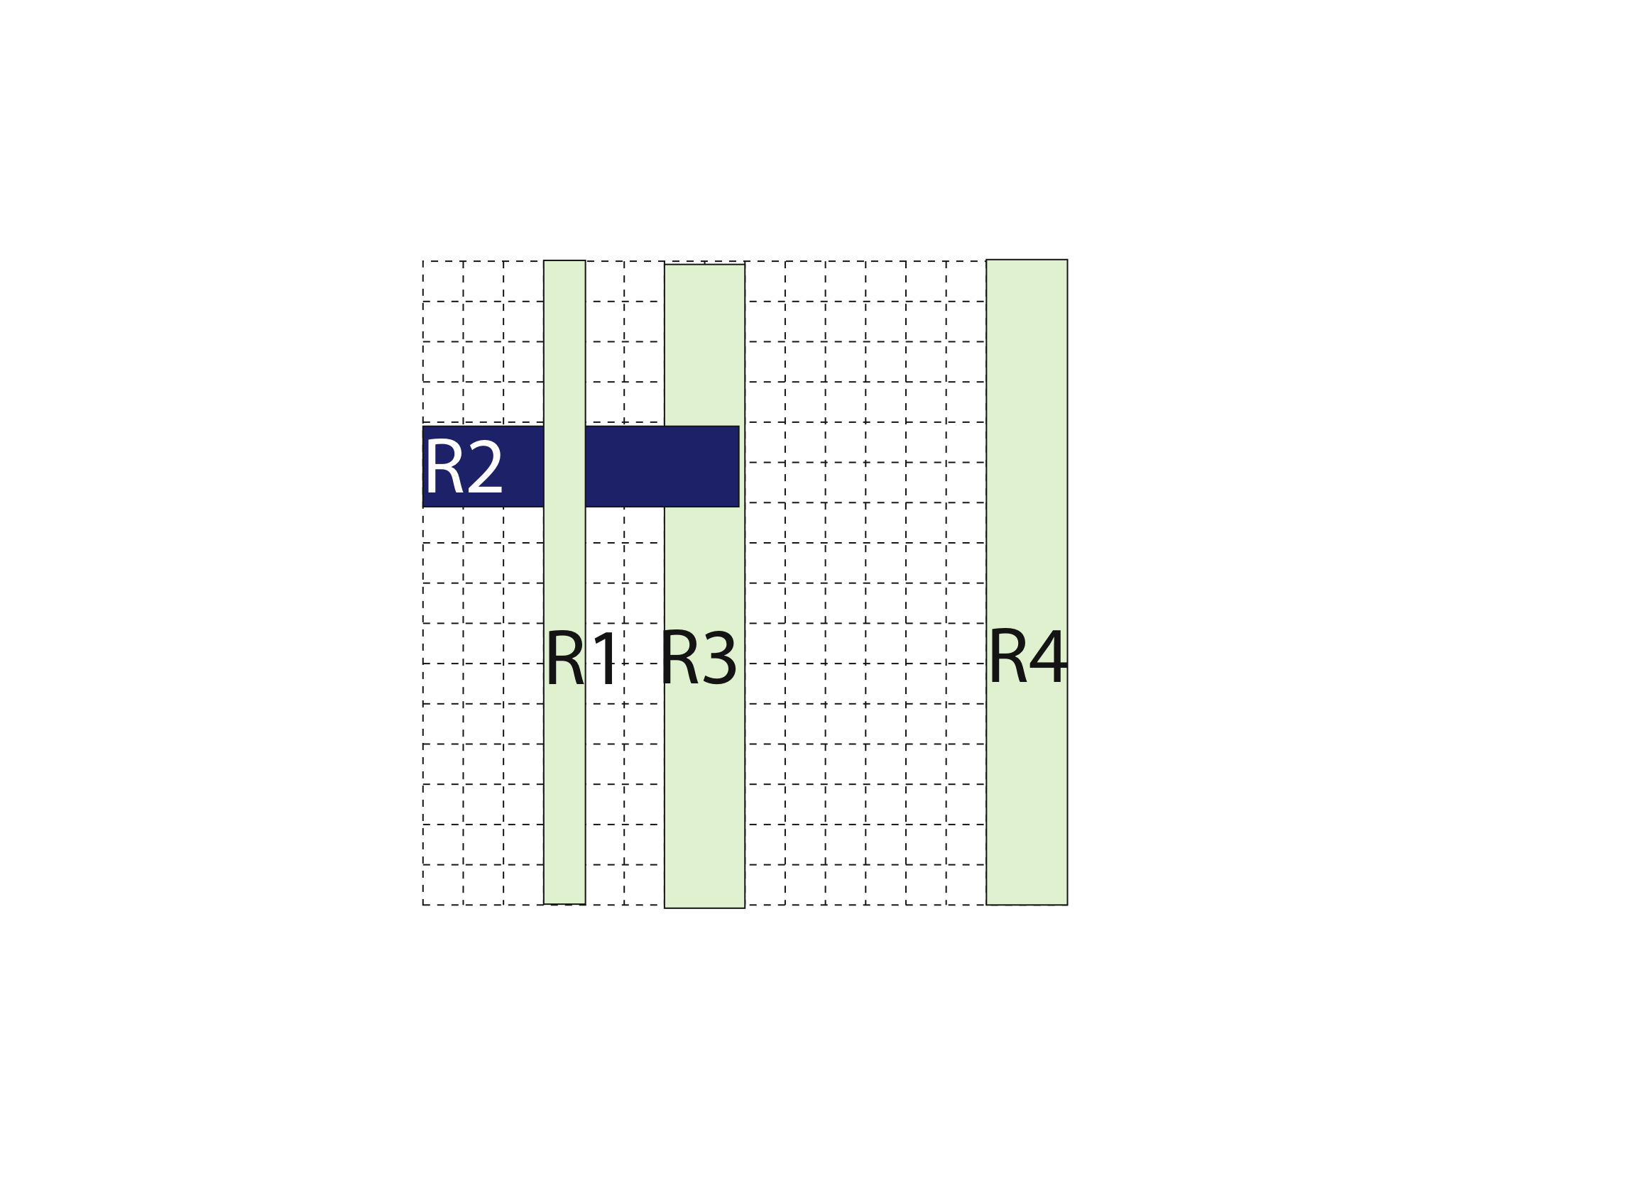
Caching Wildcard Rules
Overlapping wildcard rules
Cannot simply cache matching rules
Source: Minlan Yu

Slide 81
Caching Wildcard Rules
Multiple authority switches
Contain independent sets of rules
Avoid cache conflicts in ingress switch
Authorityswitch 1
Authorityswitch 2
Source: Minlan Yu

Slide 82

Partition Wildcard Rules
Partition rules
Minimize the TCAM entries in switches
Decision-tree based rule partition algorithm
Cut B is better than Cut A
Cut B
Cut A
Source: Minlan Yu

Slide 83
Handling Network Dynamics
Network dynamics | Cache rules | Authority Rules | Partition Rules
Policy changes at controller | Timeout | Change | Mostly no change
Topology changes at switches | No change | No change | Change
Host mobility | Timeout | No change | No change
Source: Minlan Yu

Slide 84
Summary
Controller proactively generates the rules and distributes them to authority switches
Authority switches keep packets always in the data plane and ingress switches reactively cache rules
Can the switch control plane handle all the events?
What if high level policy changes often?
What about monitoring overhead?

Slide 85
Outline
SDN scalability
Scale controller
Flat structure multiple controllers [ONIX, OSDI’10]
Recursive controller design [Xbar, ONS,13]
Hierarchical controller design [Kandoo, HotSDN’12]
Offload to switch
Offload to switch control plane [Diffane, SIGCOMM’10]
Offload of switch data plane [DevoFlow, SIGCOMM’11]

Slide 86
Dilemma
Control dilemma:
Role of controller: visibility and mgmt capability however, per-flow setup too costly
Flow-match wildcard, hash-based: much less load, but no effective control
Statistics-gathering dilemma:
Pull-based mechanism: counters of all flows full visibility but demand high BW
Wildcard counter aggregation: much less entries but lose trace of elephant flows
Aim to strike in between

Slide 87
Main Concept of DevoFlow
Devolving most flow controls to switches
Maintain partial visibility
Keep trace of significant flows
Default v.s. special actions:
Security-sensitive flows: categorically inspect
Normal flows: may evolve or cover other flows become security-sensitive or significant
Significant flows: special attention
Collect statistics by sampling, triggering, and approximating

Slide 88
Design Principles of DevoFlow
Try to stay in data-plane, by default
Provide enough visibility:
Esp. for significant flows & sec-sensitive flows
Otherwise, aggregate or approximate statistics
Maintain simplicity of switches

Slide 89
Mechanisms
Control
Rule cloning
Local actions
Statistics-gathering
Sampling
Triggers and reports
Approximate counters

Slide 90
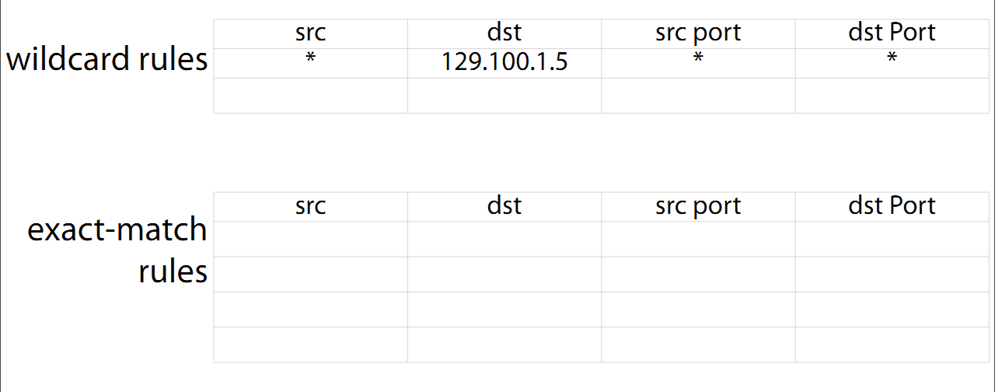
Rule Cloning
ASIC clones a wildcard rule as an exact match rule for new microflows
Timeout or output port by probability

Slide 91
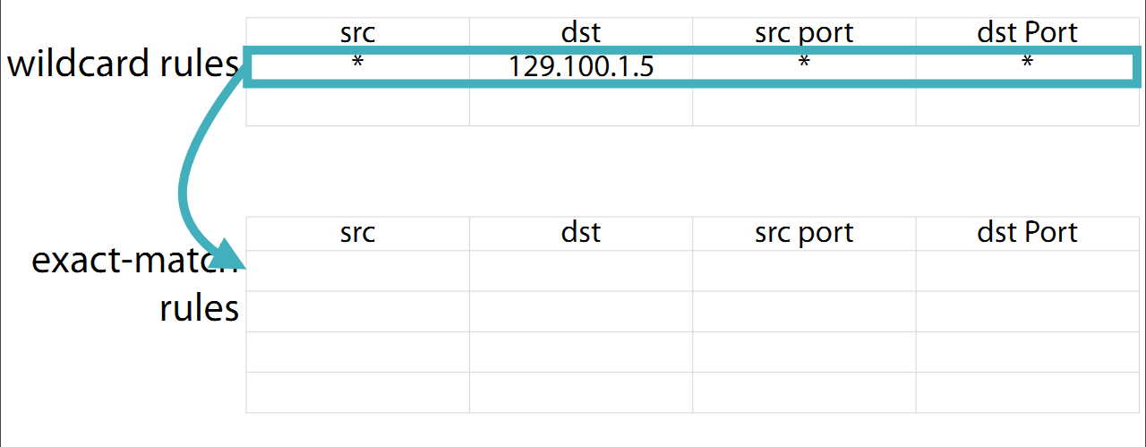
Rule Cloning
ASIC clones a wildcard rule as an exact match rule for new microflows
Timeout or output port by probability

Slide 92
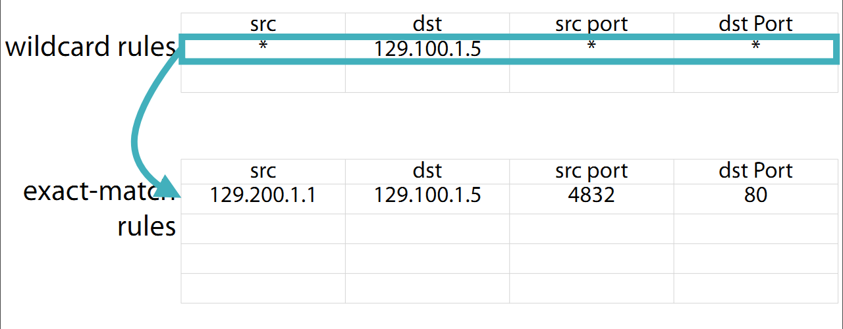
Rule Cloning
ASIC clones a wildcard rule as an exact match rule for new microflows
Timeout or output port by probability

Slide 93
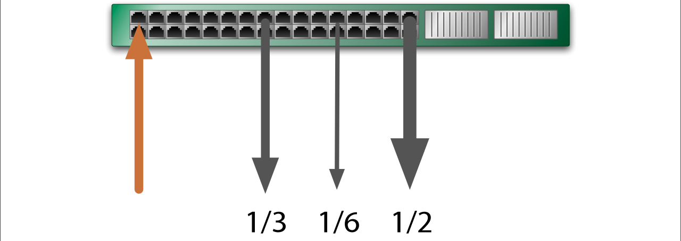
Local Actions
Rapid re-routing: fallback paths predefined ⇒Recover almost immediately
Multipath support: based on probability dist. Adjusted by link capacity or loads

Slide 94
Statistics-Gathering
Sampling
Pkts headers send to controller with1/1000 prob.
Triggers and reports
Set a threshold per rule
When exceeds, enable flow setup at controller
Approximate counters
Maintain list of top-k largest flows

Slide 95
DevoFlow Summary
Per-flow control imposes too many overheads
Balance between
Overheads and network visibility
Effective traffic engineering / network management
Switches with limited resources
Flow entries / control-plane BW
Hardware capability / power consumption

Slide 96
Thank You.
Source: Li Erran Li@Columbia, COMS 6998-8, Fall 2013

